Slide 1
Technical Deep Dive: Creating Apps for the Intelligent Cloud – Architecting for Scale
<Name & Alias of the presenters>

Slide 2
Agenda
Scalability & Architecting for Scale
Scaling Compute and Database
Caching Data
Scaling Globally with Traffic Manager
Azure CDN
Demo

Slide 3
Scalability
Notes:
The cloud is changing the way applications are designed.
The new trends bring new challenges. Application state is distributed. Operations are done in parallel and asynchronously. The system as a whole must be resilient when failures occur. Deployments must be automated and predictable. Monitoring and telemetry are critical for gaining insight into the system.
A primary advantage of the cloud is elastic scaling — So lets talk, what is scaling?

Slide 4
What is Scalability
Scalability is the ability to add additional capacity to the service to handle increases in load and demand, together with efficient and effective use of resources allocated
Users (amount of work)
Response Time (accommodate the growth)
Notes:
There are two types of scaling. 1) Manual Scale and 2) Auto-Scale
Autoscaling is the process of dynamically allocating resources to match performance requirements. As the volume of work grows, an application may need additional resources to maintain the desired performance levels and satisfy service-level agreements (SLAs). As demand slackens and the additional resources are no longer needed, they can be de-allocated to minimize costs.
Autoscaling takes advantage of the elasticity of cloud-hosted environments while easing management overhead. It reduces the need for an operator to continually monitor the performance of a system and make decisions about adding or removing resources.
There are two main ways that an application can scale:
Vertical scaling, also called scaling up and down, means changing the capacity of a resource. For example, you could move an application to a larger VM size. Vertical scaling often requires making the system temporarily unavailable while it is being redeployed. Therefore, it's less common to automate vertical scaling.
Horizontal scaling, also called scaling out and in, means adding or removing instances of a resource. The application continues running without interruption as new resources are provisioned. When the provisioning process is complete, the solution is deployed on these additional resources. If demand drops, the additional resources can be shut down cleanly and deallocated.

Slide 5
Architecting for Scale
Notes:
Design your application so that it can scale horizontally.
Okay, so now we know about scaling and the ways we can scale our applications, but the question is, in what situation should I scale my application? What are the recommendations?

Slide 6
Scalability Recommendations
Avoid instance stickiness
Identify bottlenecks
Decompose workloads by scalability requirements
Offload resource-intensive tasks
Use built-in autoscaling features
Consider aggressive autoscaling for critical workloads
Design for scale in
Notes:
https://docs.microsoft.com/en-us/azure/architecture/guide/design-principles/scale-out
Avoid instance stickiness. Stickiness, or session affinity, is when requests from the same client are always routed to the same server. Stickiness limits the application's ability to scale out. For example, traffic from a high-volume user will not be distributed across instances. Causes of stickiness include storing session state in memory, and using machine-specific keys for encryption. Make sure that any instance can handle any request.
Identify bottlenecks. Scaling out isn't a magic fix for every performance issue. For example, if your backend database is the bottleneck, it won't help to add more web servers. Identify and resolve the bottlenecks in the system first, before throwing more instances at the problem. Stateful parts of the system are the most likely cause of bottlenecks.
Decompose workloads by scalability requirements. Applications often consist of multiple workloads, with different requirements for scaling. For example, an application might have a public-facing site and a separate administration site. The public site may experience sudden surges in traffic, while the administration site has a smaller, more predictable load.
Offload resource-intensive tasks. Tasks that require a lot of CPU or I/O resources should be moved to background jobs when possible, to minimize the load on the front end that is handling user requests.
Use built-in autoscaling features. Many Azure compute services have built-in support for autoscaling. If the application has a predictable, regular workload, scale out on a schedule. For example, scale out during business hours. Otherwise, if the workload is not predictable, use performance metrics such as CPU or request queue length to trigger autoscaling. For autoscaling best practices, see Autoscaling.
Consider aggressive autoscaling for critical workloads. For critical workloads, you want to keep ahead of demand. It's better to add new instances quickly under heavy load to handle the additional traffic, and then gradually scale back.
Design for scale in. Remember that with elastic scale, the application will have periods of scale in, when instances get removed. The application must gracefully handle instances being removed. Here are some ways to handle scalein:
Listen for shutdown events (when available) and shut down cleanly.
Clients/consumers of a service should support transient fault handling and retry.
For long-running tasks, consider breaking up the work, using checkpoints or the Pipes and Filters pattern.
Put work items on a queue so that another instance can pick up the work, if an instance is removed in the middle of processing.

Slide 7
Database Bottleneck
Web Server
Site (W3WP.EXE)
Web Server
Site (W3WP.EXE)
Load Balancer
Web Site Database
Web Server
Site (W3WP.EXE)
Notes:
In a typical web application as the number of request increase the capacity of the web server will eventually be insufficient and the users will experience the application performance issues.
You can mitigate this problem by either scaling up the web server or adding additional web servers to your web farm. However, as you increase the capacity in the web front-end the load transfers to the database (or any storage subsystem you use). The database becomes a bottleneck.
As you can see in the picture, we now have sufficient web front end servers to cater the increased load but we still have one single database server which is potential performance bottleneck.

Slide 8
Mitigate Database Bottleneck
Web Server
Web Site Database
Shard #1
Site (W3WP.EXE)
Web Server
Site (W3WP.EXE)
Web Site Database
Shard #2
Load Balancer
Web Server
Site (W3WP.EXE)
Web Site Database
Shared #3
Notes:
To mitigate the database bottleneck you could scale up the database server (provide more CPU power more RAM) or you could use multiple databases (shards) and implement a data partitioning scheme. We will see later in the session, how you can easily implement sharding using elastic database client tools.

Slide 9
Reducing Further Database Load - Caching
Data Tier
Cache
Web Server
Site (W3WP.EXE)
Web Server
IIS ARR (LB)
Site (W3WP.EXE)
Web Server
Site (W3WP.EXE)
Disable session affinity.
Use cache such as Redis for reference data and user session data to reduce load on the database even further
Notes:
As the user load further increases we need to take additional design steps to prevent the database becoming a bottleneck.
We can introduce a cache such as Redis cache to store user session data and slowly changing reference/master data (such as zip codes, product catalogue, etc) so that the read workload is served from the cache reducing the load on the database.
Also as the session data is stored out of process we can disable the session affinity to ensure users can connect to any web server in the farm utilizing fully the compute capacity provided in the web farm.

Slide 10

Background processing decoupling
Worker
Worker process
request queue
Web Server
Site (W3WP.EXE)
Load Balancer
Web Site Database
response queue
Notes:
Another way to improve scalability and perceived performance of the system is to decouple background processing from the web server and implement is on a separate worker process. The worker process in Azure can be implemented as process on a Function App or as a WebJob.
The web server can then use Azure storage queues to communicate with the worker process asynchronously.
The use of queues has additional benefits such as load leveling discussed later on , essentially queues provide a buffer against the load from the web tier meaning that the worker can process the messages at a constant rate.
There is another session on batch and background processing if you want to learn more about it.

Slide 11
Background processing decoupling & scaling
Worker
Web Server
Worker process
Site (W3WP.EXE)
request queue
Web Server
Site (W3WP.EXE)
Load Balancer
Web Site Database
response queue
Web Server
Worker
Site (W3WP.EXE)
Worker process
Notes:
This type of architecture can use scaling in the web front end and the worker tier. In fact, you can scale them independently.
Multiple web front-ends and workers improves scalability. Also reliability is increased because even if the worker should fail another one is available to do it´s task.
However, for the scaling to work you need to design your application appropriately for example you should ensure that message produced by any web server can be processed by any worker. Remember, that if you implement autoscaling the number of webservers in the farm and the number of workers can go up as well as down.

Slide 12
Scalability Enablers
Increasing Compute On-Demand (AutoScale)
Microservices approach
Caching Data (Redis Cache)
Routing Users to Closest Datacenter (Traffic Manager)
Leveraging Asynchronous APIs

Slide 13
Scaling Compute

Slide 14
Compute Scaling Options (Azure App Service)
Scale Up (vertical)
Small to Large Instance Sizes
*) max 8 cores/14GB P4 Plan, 250GB storage
New Isolated Plan: Dv2-series VMs
Scale Out (horizontal)
Add Additional Instances
Basic Plan: Up to 3 Dedicated Instances
Standard Plan: Up to 10 Dedicated Instances
Premium Plan: Up to 20 or 50 (ASE) Dedicated Instances
Isolated Plan: Up to 100 Dedicated Instances
LARGE
4 CORES
7 GB MEMORY
50 GB STORAGE
MEDIUM
2 CORES
3.5 GB MEMORY
10 GB STORAGE
SMALL
1 CORE
1.75 GB MEMORY
1 GB STORAGE
https://azure.microsoft.com/en-in/pricing/details/app-service/
Notes:
Purpose: explain how CPU and Memory of web servers can be adjusted in PaaS Service , here Azure App Service– what are the limits?
Detail:
https://azure.microsoft.com/en-in/pricing/details/app-service/
There are two compute scaling options available to applications hosted in Azure.
In vertical scaling you increase the machine size (RAM and # of cores).
When you scale out (horizontal scaling) or in, you are adding or removing servers in the web farm that have the same specification (size).
The Standard plan S3 and P3 Premium are limited to 4 core 7GB machines.
In the Application Service Environment (ASE) (which is a private hosting of Azure App service, rather than the multitenant Azure App service) the P4 Premium plan will allow up to 50 machines 8 core /14GB machines.
Isolated Service Plan: Designed to run mission critical workloads, which are required to run in a virtual network. The Isolated plan allows customers to run their apps in a private, dedicated environment in an Azure datacenter using Dv2-series VMs with faster processors, SSD storage and double the memory-to-core ratio compared to Standard. The plan can scale to 100 instances with more available upon request. Its App Service Environment (ASE) V2
If you need more processing power then consider Azure Virtual machine scale set as a service to host your compute.

Slide 15
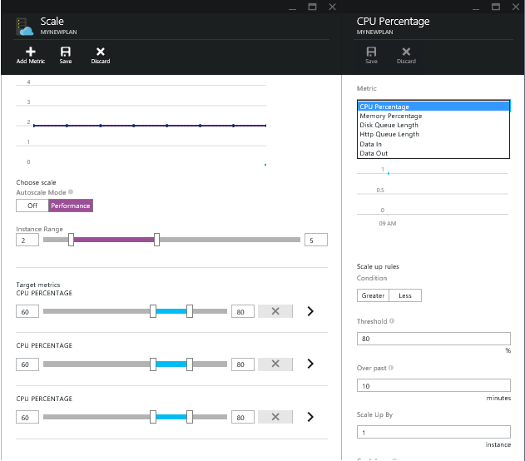
Auto-scaling Compute
Metric based
Time based
Storage Queue based
( Web/Worker Roles)
Multiple rules allowed
System must be designed for horizontal scalability
No process affinity
Must be stateless
Notes:
Purpose: auto-scaling feature for assigning compute resources dynamically
https://azure.microsoft.com/en-us/documentation/articles/web-sites-scale/
Detail:
In Auto-scaling can automatically increase the capacity of the farm based on the actual demand (usage) of the web application.
Auto-scaling is available in Standard, Premium & Isolated plan. You can define the rules based on a number of metrics (HTTP queue length, CPU Percentage or memory utilization).
In web farms with multiple machines an average is computed across all instances.
Auto scaling rules based on schedule time let you assign different number of machines to your web farm on weekends, workdays or specific dates or time in a day.
https://github.com/mspnp/azure-guidance/blob/master/Auto-scaling.md
To use auto-scaling you have to design the system for horizontal scalability. Because the auto-scaling rule can add or remove machines dynamically you should not assume that request will be routed to the same instance (machine) and you should not persist any state on the instance.
If a queue is used than no assumptions should be made about the instance that wrote message to the queue.
Autoscaling rules that use a detection mechanism based on a measured trigger attribute (such as CPU usage or queue length) use an aggregated value over time, rather than the instantaneous values, to trigger an autoscaling action. By default, the aggregate is an average of the values. This prevents the system from reacting too quickly, or causing rapid oscillation. It also allows time for new instances that are auto-started to settle into running mode, preventing additional autoscaling actions from occurring while the new instances are starting up. For Cloud Services and Virtual Machines, the default period for the aggregation is 45 minutes, so it can take up to this period of time for the metric to trigger autoscaling in response to spikes in demand. You can change the aggregation period by using the SDK, but be aware that periods of less than 25 minutes may cause unpredictable results (see Auto Scaling Cloud Services on CPU Percentage with the Windows Azure Monitoring Services Management Library for more information). For Azure Web Sites, the averaging period is much shorter, allowing new instances to be available in around five minutes after a change to the average trigger measure.
Competing Consumers Pattern is the relevant pattern here.

Slide 16

VM Scale Sets
High performance provisioning of 1000+ VMs
Auto-configuration at scale
Auto-scale based on schedule and resource metrics
Easy updates at scale
Simple Portal Integration
Notes:
So, VMs are great… but managing a lot of them individually can be hard. That’s where VM scale sets comes in..
The goal here is to enable management of like VMs as a group and make it easy to scale them in/out based on demand.

Slide 17
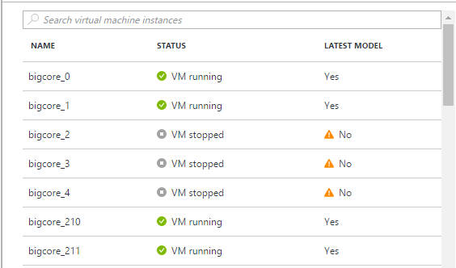
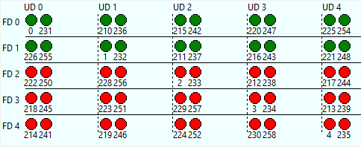
Why VM Scale Sets?
Modern cloud applications need:
Scale - Deploy identical resources
Easily
Rapidly
At scale.. 10s – 10,000s of cores
Customization – PaaS-like ease of use with custom infrastructure requirements
Availability - Roll out updates without service interruption
Low cost - Dynamically increase/decrease compute power to optimize costs
Elasticity - Automatically scale to changing demand
Notes:
A scale set supports up to 1,000 VMs. If you create and upload your own custom VM images, the limit is 300.
You can look at scale sets as an infrastructure that supports PaaS. PaaS solutions like Service Fabric build on this infrastructure.
A scale set is an implicit availability set with 5 fault domains and 5 update domains. Scale sets of more than 100 VMs span multiple placement groups, which are equivalent to multiple availability sets.
To maintain consistent application performance, you can automatically increase or decrease the number of VM instances in your scale set. This autoscale ability reduces the management overhead to monitor and tune your scale set as customer demand changes over time.

Slide 18
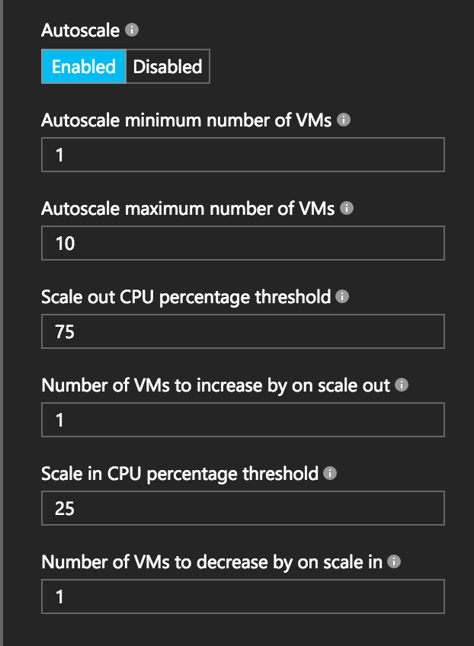
Autoscale with VM Scale Sets
Define Max – Min VMs
Define trigger and action rules
Standard audit / email notifications
Define webhooks for custom notifications and actions (e.g. runbooks)
Notes:
Metrics emitted by Azure Diagnostic Extension
Triggers can be basic performance metrics, and also schedule based, queue length based.
https://docs.microsoft.com/en-us/azure/virtual-machine-scale-sets/virtual-machine-scale-sets-autoscale-portal

Slide 19




Azure Service Fabric
Any OS, Any Cloud
containers and microservices
Lifecycle
Management
Always On Availability
Programming Models
Health & Monitoring
Dev & Ops Tooling
Auto
scaling
Orchestration
Dev Machine
Azure
On Premise
Infrastructure
Other Clouds
Notes:
Service Fabric is Microsoft's container orchestrator deploying microservices across a cluster of machines.
Service Fabric runs everywhere. You can create clusters for Service Fabric in many environments, including Azure or on premises, on Windows Server, or on Linux. You can even create clusters on other public clouds. In addition, the development environment in the SDK is identical to the production environment, with no emulators involved. In other words, what runs on your local development cluster deploys to the clusters in other environments.
Any OS, Any Cloud.
Insurance/Financial App can deploy SF on-prem.
Lifecycle Management – As with other platforms, an application on Service Fabric usually goes through the phases: design, development, testing, deployment, upgrade, maintenance, and removal. Service Fabric provides first-class support for the full application lifecycle of cloud applications, from development through deployment, daily management, and maintenance to eventual decommissioning.
Always-On Availability – SF has Built in resiliency. Even if one of the instances fail, the replicated instance becomes the primary automatically.
Programming Models - Service Fabric offers multiple ways to write and manage your services. Guest executables, Containers, Reliable Services, Reliable Actors, ASP.NET Core
Health & Monitoring - Service Fabric introduces a health model designed to flag unhealthy cluster and application conditions on specific cluster nodes and service replicas.
DevOps Tooling – VSTS, Jenkins
https://docs.microsoft.com/en-us/azure/service-fabric/service-fabric-content-roadmap

Slide 20


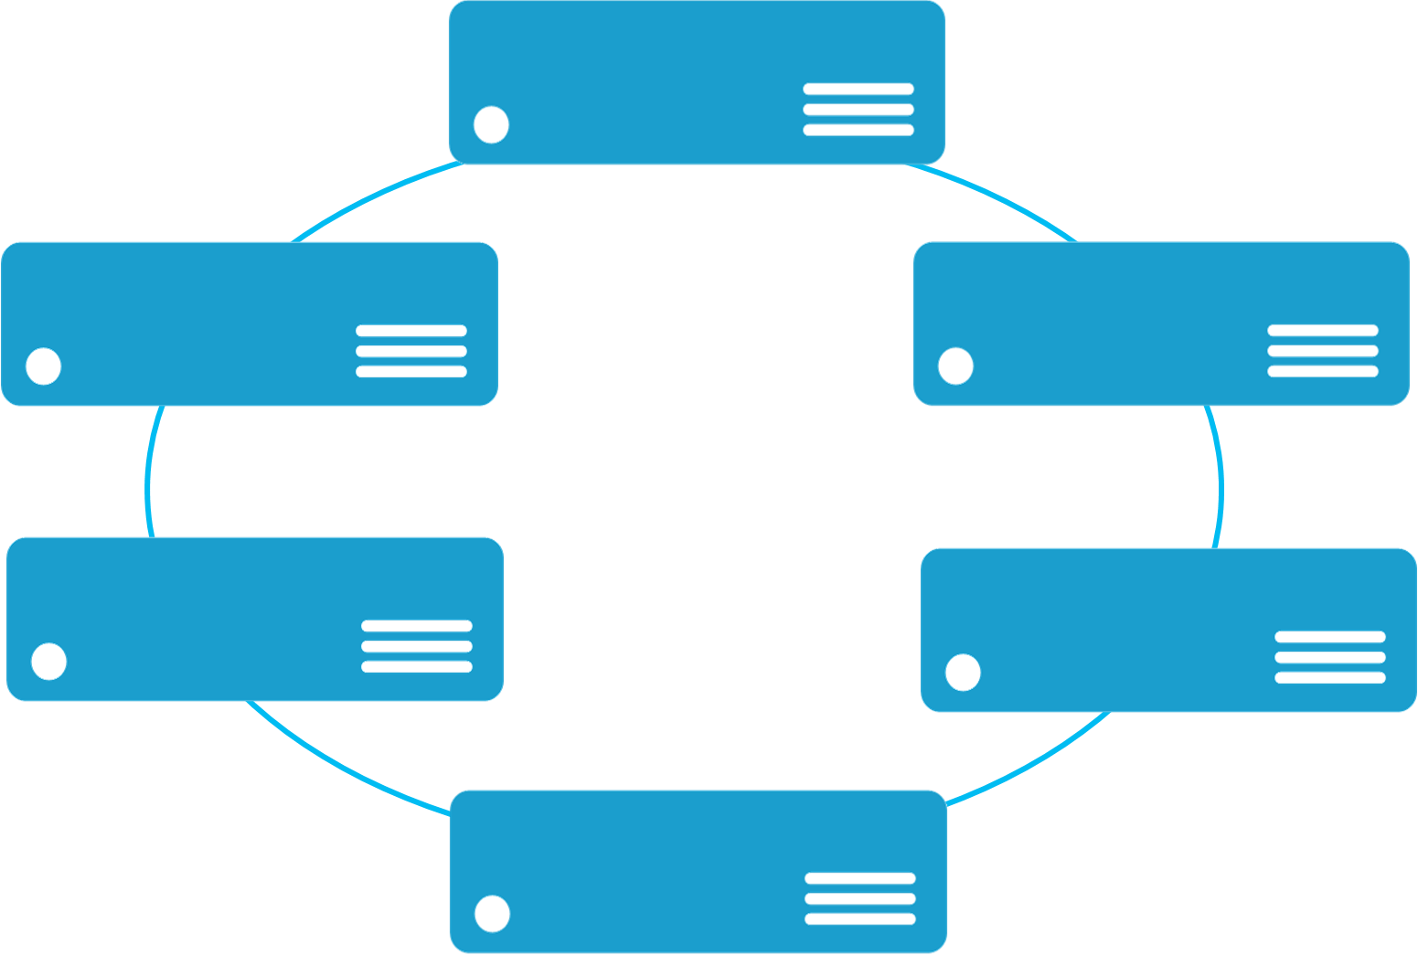


Monolithic application approach
Microservices application approach
A monolith app contains domain specific functionality and is normally divided by functional layers such as web, business and data
App 1
App 1
App 2
A microservice application separates functionality into separate smaller services.
Scales by cloning the app on multiple servers/VMs/Containers
Scales out by deploying each service independently creating instances of these services across servers/VMs/containers
Notes:
Monolithic
During the client-server era, we tended to focus on building tiered applications by using specific technologies in each tier. The term monolithic application has emerged for these approaches.
There are benefits to such a monolithic design approach. It's often simpler to design, and it has faster calls between components, because these calls are often over interprocess communication (IPC).
The downside is that there's a tight coupling between tiered layers, and you cannot scale individual components. If you need to perform fixes or upgrades, you have to wait for others to finish their testing. It is more difficult to be agile.
Microservices
The benefits of microservices are that each one typically encapsulates simpler business functionality, which you scale up or down, test, deploy, and manage independently.
The downside of microservices comes in managing the increased number of separate entities and dealing with more complex deployments and versioning.
https://docs.microsoft.com/en-us/azure/service-fabric/service-fabric-overview-microservices

Slide 21




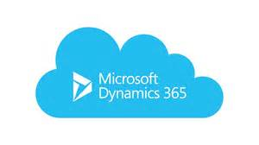




Services Powered by Service Fabric
Cosmos DB
Billions transactions/day
IoT Hub
Millions of messages
Event Hubs
60bn events/day
SQL Database
2.1 million DBs
Microsoft runs its business on Service Fabric
Skype
Cortana
Intune
Dynamics
Power BI
Designed for mission critical tier 1 workloads
30% of Azure cores run Service Fabric
Notes:
We are deploying lots of azure mission critical services on Service Fabric, you can imagine what if SQL Azure goes down.
Microsoft itself runs its business on Service Fabric.

Slide 22
Running Microservices at Scale
Notes:
Azure Service Fabric makes it easy to build scalable applications by managing the services, partitions, and replicas on the nodes of a cluster.
Scaling in Service Fabric is accomplished several different ways:
Scaling by creating or removing stateless service instances: When you create a stateless service, you get a chance to define an InstanceCount. InstanceCount defines how many running copies of that service's code are created when the service starts up.
Scaling by creating or removing new named services: New named service instances can be created (or removed) as services become more or less busy. This allows requests to be spread across more service instances, usually allowing load on existing services to decrease.
Scaling by creating or removing new named application instances: there's some manager service that is making the decision based on the requests that it is seeing and the information it is receiving from the other services inside the cluster.
Scaling by using partitioned services: Partitioning splits a service into several logical and physical sections, each of which operates independently.
Scaling by adding and removing nodes from the cluster: Metrics are how services express their resource consumption to Service Fabric.
Scaling by using Cluster Resource Manager metrics: Another option for scaling with Service Fabric is to change the size of the cluster. Changing the size of the cluster means adding or removing nodes for one or more of the node types in the cluster.

Slide 23
Service partitioning
Services can be partitioned for scale-out.
You can choose your own partitioning scheme.
Service partitions are striped across machines in the cluster.
Replicas automatically scale out & in on cluster changes
Node 1
Node 2
Node 3
Node 4
Node 5
Node 6
S
P2
P1
S
S
S
S
P3
P4
S
S
S
Notes:
Partitioning is not unique to Service Fabric. In fact, it is a core pattern of building scalable services. In a broader sense, we can think about partitioning as a concept of dividing state (data) and compute into smaller accessible units to improve scalability and performance. A well-known form of partitioning is data partitioning, also known as sharding.
https://docs.microsoft.com/en-us/azure/service-fabric/service-fabric-concepts-partitioning

Slide 24
Scaling Azure SQL Database
Notes:
In many large-scale solutions, data is divided into separate partitions that can be managed and accessed separately. The partitioning strategy must be chosen carefully to maximize the benefits while minimizing adverse effects. Partitioning can help improve scalability, reduce contention, and optimize performance. Another benefit of partitioning is that it can provide a mechanism for dividing data by the pattern of use. For example, you can archive older, less active (cold) data in cheaper data storage.

Slide 25
Scaling Azure SQL Database
Scale Up (vertical)
Add more resources to the database node
Scale Out (horizontal)
Partition data to host on multiple nodes.
Shard mgr
Premium
Standard
Shard1
Shard2
Shard 3
Basic
Notes:
https://docs.microsoft.com/en-us/azure/sql-database/sql-database-elastic-scale-introduction#horizontal-and-vertical-scaling
Horizontal scaling refers to adding or removing databases in order to adjust capacity or overall performance. This is also called “scaling out”. Sharding, in which data is partitioned across a collection of identically structured databases, is a common way to implement horizontal scaling.
Vertical scaling refers to increasing or decreasing the performance level of an individual database—this is also known as “scaling up.”
Most cloud-scale database applications will use a combination of these two strategies. For example, a Software as a Service application may use horizontal scaling to provision new end-customers and vertical scaling to allow each end-customer’s database to grow or shrink resources as needed by the workload.

Slide 26

Azure SQL Database Active Geo-Replication
Available in Premium Tier
Multiple read-only secondary's (max 4)
Application uses secondary's for read only workloads
r/o Replica 1
Application
r/w Primary
r/o Replica 4
Notes:
Active geo-replication available in the Premium service tier of SQL Azure database can be leveraged by applications.
Though the primary scenario is business continuity, active replication can be used to create database replicas that the application can use for read only workloads such as reporting. Application would pick a secondary based on random or round robin selection.
In this way the primary database receives a reduced load.
Active geo-replication leverages the Always On technology of SQL Server to asynchronously replicate committed transactions on the primary database to a secondary database using read committed snapshot isolation (RCSI).
The primary database asynchronously replicates committed transactions to each of the online secondary databases. While at any given point, the online secondary data might be slightly behind the primary database, the online secondary data is guaranteed to always be transactionally consistent with changes committed to the primary database.
An online secondary can act as a load balancer for read workloads such as reporting. While you can create an online secondary in a different region for disaster recovery, you could also have an online secondary in the same region on a different server. Both online secondary databases can be used to balance read only workloads serving clients distributed across several regions.

Slide 27
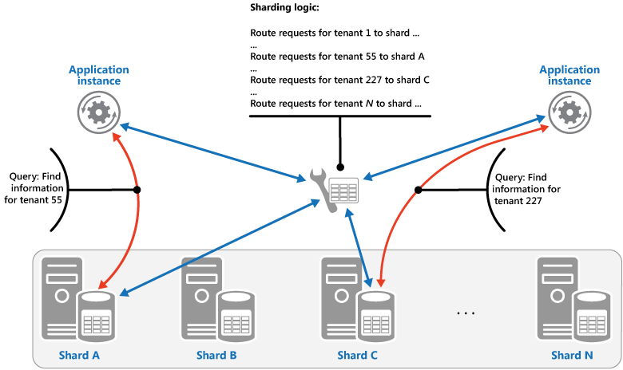
Sharding Pattern
Divide a data store into a set of horizontal partitions or shards. This pattern can improve scalability when storing and accessing large volumes of data.
Notes:
Sharding is a technique to distribute large amounts of identically-structured data across a number of independent databases. It is especially popular with cloud developers creating Software as a Service (SAAS) offerings for end customers or businesses. These end customers are often referred to as “tenants”. Sharding may be required for any number of reasons:
The total amount of data is too large to fit within the constraints of a single database
The transaction throughput of the overall workload exceeds the capabilities of a single database
Tenants may require physical isolation from each other, so separate databases are needed for each tenant
Different sections of a database may need to reside in different geographies for compliance, performance or geopolitical reasons.

Slide 28
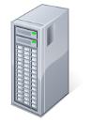
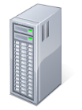


SQL Azure Scaling Out
Shard Map Manager and Shard DBs
Data-dependent routing
Multi-shard querying
Elastic database pool
Key | Shard
1 | Server 1, DB A
2 | Server 1, DB A
3 | Server 1, DB A
4 | Server 1, DB A
DB A
DB B
List Map
Shard Map
Manager
Application
Application
Developer
Key Range | Shard
100-500 | Server 1, DB C
500-1000 | Server 2, DB D
1000-1500 | Server 3, DB E
1500-2000 | Server 4, DB F
DB C
DB E
DB D
Range Map
DB F
Notes:
Applications connect to the Shard Map Manager database that will use the shard map to route query to appropriate database (data dependent routing).
It is also possible to launch queries across multiple shard databases using multi-shard querying. You take advantage of these two features using Elastic Database Client Tools that provide respective APIs.
The databases can also be assigned to elastic database pool where Azure will assign the required amout of DTUs to the database that needs it.
More background detail:
In a sharded database environment Shard Map Manager database maintains, a shard map containing information that allows an application to connect to the correct database based upon the value of the sharding key. Understanding how these maps are constructed is crucial to managing shards in the Elastic Scale preview.
Shard maps can be constructed using lists of individual sharding key values, or they can be constructed using ranges of sharding key values. In this figure there are couple of examples, the first is using a List Map which contains the Shard that contains data rows based on keys; while the lower piece assigns ranges of keys to different shards or databases.
In the Elastic Scale APIs, the Shard Map Manager is a collection of shard maps. The data managed by a ShardMapManager .Net object is kept in three places: Global Shard Map (GSM): When you create a ShardMapManager, you specify a database (or shard) to serve as the repository for all of its shard maps and mappings. Special tables and stored procedures are automatically created to manage the information. This is typically a small database and lightly accessed, but it should not be used for other needs of the application.
Also, Every database that you specify to be a shard within a shard map will be modified to contain several small tables and special stored procedures that contain and manage shard map information specific to that shard. This information is redundant to the information in the global shard map but it allows the application to validate cached shard map information without placing any load on the GSM; this is called the Local Shard Map (LSM)
In addition to that, Each application instance accessing a ShardMapManager object maintains a local in-memory cache of its mappings. It stores routing information that has recently been retrieved. This serves as an Application Level Cache.
It is worthwhile to note here that Methods used for populating or changing the ShardMapManager data do not alter the user data stored in the shards themselves. For example, there are methods to Create Shard, Delete Shard and UpdateMapping. These will only affect the shard map metadata, they do not remove, add, or alter user data contained in the shards. Instead, these methods are designed to be used in conjunction with separate operations you perform to create or remove actual databases, or that move rows from one shard to another to rebalance a sharded environment.

Slide 29
Tenancy models for SaaS Apps
Single-tenant per database
Single tenant per database
Each tenant’s data is stored in a different database
Better isolation of tenants as compared to multi-tenant model
Multiple tenants per database
Multiple tenants share the same database
Less isolation of tenants as compared to single tenant model
Typically more cost-effective than the single tenant model
Hybrid model
Some tenants share databases, others get their own database
E.g., premium or paying customers get their own databases, while free tier customers share databases
DB₁
DB₂
Customer 1
Customer 2
…
Multi-tenant per database
DB₁
DB₂
Customer 1
Customer 4
…
Customer 2
Customer 5
Customer 3
Customer 6
Notes:
Single-tenant
Some applications use the simplest approach of creating a separate database for each tenant. This is the single tenant sharding pattern that provides isolation, backup/restore ability and resource scaling at the granularity of the tenant. With single tenant sharding, each database is associated with a specific tenant ID value (or customer key value), but that key need not always be present in the data itself. It is the application’s responsibility to route each request to the appropriate database - and the client library can simplify this.
Multi-tenant
Others scenarios pack multiple tenants together into databases, rather than isolating them into separate databases. This is a typical multi-tenant sharding pattern - and it may be driven by the fact that an application manages large numbers of very small tenants. In multi-tenant sharding, the rows in the database tables are all designed to carry a key identifying the tenant ID or sharding key. Again, the application tier is responsible for routing a tenant’s request to the appropriate database, and this can be supported by the elastic database client library. In addition, row-level security can be used to filter which rows each tenant can access
https://docs.microsoft.com/en-us/azure/sql-database/sql-database-elastic-scale-introduction

Slide 30
Demo

Slide 31


Azure SQL Database Auto-scaling
via Powershell
automate with Azure Automation
Azure Automation (SE)
Set-AzureSqlDatabase $ctx $db -MaxSizeGB 50
-ServiceObjective $serviceObjective
-Force
Admin/
DevOps
Vertical scaling
DB₆
_{[500-600)}
DB₅
_{[400-500)}
DB₄
_{[300-400)}
Horizontal scaling
DB₁
_{[0-100)}
DB₂
_{[100-200)}
DB₃
_{[200-300)}
DB_{n}
_{[n-n+100)}
. . .
S0
S0
S0
S2
P1
P3
time
Notes:
There is no built in autoscaling feature in SQL Database service. However Scaling can be implemented
Via PowerShell and automated with Azure Automation that allows you to run PowerShell scripts on a schedule.
It is not practical to scale db on the fly, this is only a rare scale up scenario.
-You can make up to four individual database changes (service tier or performance levels) within a 24 hour period.
-If downgrading from Premium tier with geo-replication you would needs to stop the geo-replication relationships with secondary's.
- When downgrading you would need to watch the database size limits
-A SLO change for a database often involves data movement and therefore many hours may elapse before the change request completes and the associated billing change becomes effective. Data movement occurs for changes when upgrading a database and may also occur when changing performance level of the database. Scaling-up large database can take days
Generally, there is no data movement if the database performance level is changed from a higher performance level to a smaller size. In such cases, the latency of the SLO change is much faster and typically completes in the order of seconds.

Slide 32
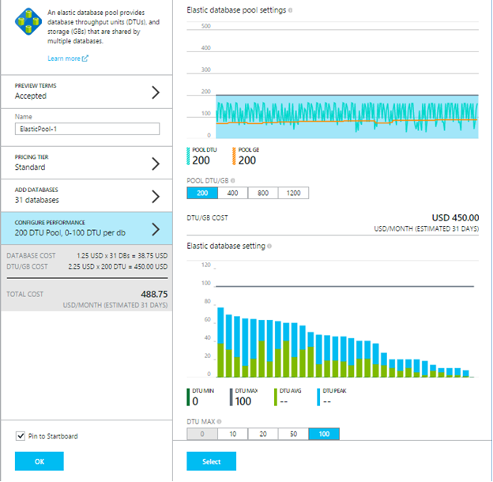
Azure Elastic Database Pool
Azure manages DTU assignment
Set min/max DTU per database
Add remove databases from pool
Notes:
Purpose: explain how performance can be optimized by using Azure SQL Elastic Database Pool
Detail:
https://azure.microsoft.com/en-us/documentation/articles/sql-database-elastic-pool/
SaaS ISVs with a large number of SQL Azure databases (single tenant per database) face problem of optimal DTU assignment. Some tenants may be less active than others, and likely not all tenants are active at the same time.
Azure Elastic Database Pool is currently a preview feature. It allows you to move SQL azure databases to the pool which has a desired DTU capacity. The DTUs from the pool are assigned automatically to the SQL Databases in the pool depending on their needs. You can specify minimum and maximum nr. of DTUs that any one database can be assigned and the total of DTUs available in the pool.
You can add or remove databases at any time to and from the pool and Azure offers a wizard that uses machine learning algorithm to suggest databases that are good candidates to move to the pool.
A database with constant load (DTU needs) is not a good candidate for pool, neither database that may spike beyond the DTU pool capacity.

Slide 33




Azure Cosmos DB A globally distributed, massively scalable, multi-model database service
Table API
Column-family
Document
Key-value
Graph
Elastic scale out
of storage & throughput
Guaranteed low latency at the 99th percentile
Five well-defined consistency models
Turnkey global distribution
Comprehensive SLAs
Notes:
Azure Cosmos DB is Microsoft's globally distributed, multi-model database. With the click of a button, Azure Cosmos DB enables you to elastically and independently scale throughput and storage across any number of Azure's geographic regions. It offers throughput, latency, availability, and consistency guarantees with comprehensive service level agreements (SLAs), something no other database service can offer.
APIs for the following data models are supported with SDKs available in multiple languages:DocumentDB API: A schema-less JSON database engine with SQL querying capabilities.
MongoDB API: A MongoDB database service built on top of Cosmos DB. Compatible with existing MongoDB libraries, drivers, tools and applications.
Table API: A key-value storage database service built to provide premium capabilities for Azure Table storage applications.
Graph (Gremlin) API: A graph database service built following the Apache TinkerPop specification.
Additional data models coming soon!
Write globally distributed applications, the right way
Five consistency models models provide a spectrum of strong SQL-like consistency all the way to NoSQL-like eventual consistency, and every thing in between.
Money back guarantees
Your data gets there fast, or your money back.
Service level agreements for availability, latency, throughput, and consistency.

Slide 34
Azure Cosmos DB
Globally-distribute data around the world
Turn-key global distribution
Automatically replicate all your data around the world – across more regions than Amazon and Google combined
Notes:
Turnkey global distribution
You can distribute your data to any number of Azure regions, with the click of a button. This enables you to put your data where your users are, ensuring the lowest possible latency to your customers.
Using Azure Cosmos DB's multi-homing APIs, the app always knows where the nearest region is and sends requests to the nearest data center. All of this is possible with no config changes. You set your write-region and as many read-regions as you want, and the rest is handled for you.

Slide 35
Elastically scalable storage
System designed to independently scale storage and throughput
Transparent server side partition management and routing
Automatically indexed SSD storage
Automatic global distribution of data across any number of Azure regions
Optionally evict old data using built-in support for TTL
15
Social data/Machine-generated data
PB
TB
Log 10 Scale
Data volume
Web/content data
GB
Log 10 scale
Transaction
data
MB
KB
1
Data variety/complexity
Notes:
Elastically scale throughput and storage on demand, worldwide
Easily scale database throughput at a per-second granularity, and change it anytime you want.
Scale storage size transparently and automatically to handle your size requirements now and forever.
Dynamically add and remove regions
Azure Cosmos DB allows you to add (associate) or remove (dissociate) regions to your database account at any point in time (see preceding figure). By virtue of replicating data across partitions in parallel, Azure Cosmos DB ensures that when a new region comes online, Azure Cosmos DB is available within 30 minutes anywhere in the world for up to 100 TBs.
https://docs.microsoft.com/en-us/azure/cosmos-db/distribute-data-globally

Slide 36
Elastically scalable throughput, globally
Elastically scale throughput from 10 to 100s of millions of requests/sec across multiple regions
Customers pay by the hour for the provisioned throughput
Transparent server side partition management and routing
Support for requests/sec and requests/min for different workloads
12000000
10000000
8000000
6000000
4000000
2000000
Black Friday
Provisioned request / sec
Nov 2016
Dec 2016
Time
Hourly throughput (request/sec)
Notes:
With Azure Cosmos DB, reserved throughput is specified in terms of request units processing per second. You can think of request units as throughput currency, whereby you reserve an amount of guaranteed request units available to your application on per second basis. Each operation in Azure Cosmos DB - writing a document, performing a query, updating a document - consumes CPU, memory, and IOPS. That is, each operation incurs a request charge, which is expressed in request units.
To help customers fine tune their throughput estimations, there is a web based request unit calculator to help estimate the request unit requirements for typical operations.
https://docs.microsoft.com/en-us/azure/cosmos-db/request-units

Slide 37
Session Break

Slide 38
Caching Data

Slide 39
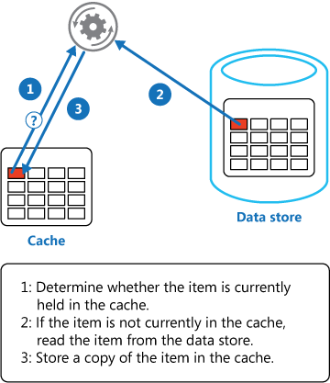
Cache-Aside Pattern
Load data on demand into a cache from a data store. This pattern can improve performance and also helps to maintain consistency between data held in the cache and the data in the underlying data store.
Notes:
Context and problem
Applications use a cache to improve repeated access to information held in a data store. However, it's impractical to expect that cached data will always be completely consistent with the data in the data store. Applications should implement a strategy that helps to ensure that the data in the cache is as up-to-date as possible, but can also detect and handle situations that arise when the data in the cache has become stale.
Solution
Use this pattern when:
•A cache does not provide native read-through and write-through operations.
•Resource demand is unpredictable. This pattern enables applications to load data on demand. It makes no assumptions about which data an application will require in advance.
This pattern might not be suitable:
•When the cached data set is static. If the data will fit into the available cache space, prime the cache with the data on startup and apply a policy that prevents the data from expiring.
•For caching session state information in a web application hosted in a web farm. In this environment, you should avoid introducing dependencies based on client-server affinity.

Slide 40
Azure Redis Cache
Available in 3 Tiers
Basic: Single Node Cache
Standard: Two-Node Primary/Secondary with automatic replication between the two nodes
Premium: Disaster recovery, enhanced security
Cache Sizes
250 MB, 1 GB, 2.8 GB, 6 GB, 13 GB, 26 GB, 53GB, 530 GB
Notes:
Purpose: Introduce Redis cache
Detail:
Azure Redis Cache is based on the popular open source Redis cache. It gives you access to a secure, dedicated Redis cache, managed by Microsoft and accessible from any application within Azure.
Azure Redis Cache is available in the following tiers:
Basic—Single node, multiple sizes, ideal for development/test and non-critical workloads. The Basic tier has no SLA.
Standard—A replicated cache in a two-node primary/secondary configuration managed by Microsoft, with a high-availability SLA.
Premium—All of the Standard tier features, including a high-availability SLA, as well as better performance over Basic and Standard-tier caches, bigger workloads, disaster recovery, enhanced security and more.
https://azure.microsoft.com/en-in/services/cache/

Slide 41
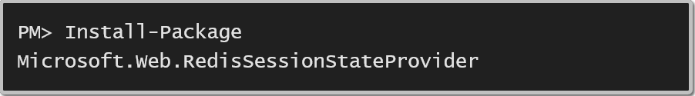
Redis Cache Providers for ASP.Net Applications
ASP.Net Session State Provider
ASP.Net Page Output Cache Provider
Available via Nuget
Simple configuration in web.config
Notes:
Purpose: explain provider model for ASP.Net applications
Detail:
https://docs.microsoft.com/en-us/azure/redis-cache/cache-aspnet-session-state-provider
https://docs.microsoft.com/en-us/azure/redis-cache/cache-aspnet-output-cache-provider
We have mentioned before that session state should be stored out of process to allow scaling out of the web farm. For ASP.Net applications both session state and page output cache providers are available and can easily be added to the application by Session State and Output Cache provider.
Azure Redis Cache provides a session state provider that you can use to store your session state in a cache rather than in-memory or in a SQL Server database. To use the caching session state provider, first configure your cache, and then configure your ASP.NET application for cache using the Redis Cache Session State NuGet package.
The Redis Output Cache Provider is an out-of-process storage mechanism for output cache data. This data is specifically for full HTTP responses (page output caching). The provider plugs into the new output cache provider extensibility point that was introduced in ASP.NET 4.

Slide 42
Redis Cache
Redis Cache
Multi-tenant managed service
Key-Value store, where keys can be strings
or structures (hash, list, set, sorted set)
Support for Transactions, Pub/Sub, Limited TTL Keys
Memcached Cloud (Redis Labs)
Multi-tenant service managed by Redis Labs
Available in the Azure Store as an Add-On
// Simple cache-aside pattern
string value = cache.StringGet("key1");
if (value == null) {
value = GetValueFromDataSource();
cache.StringSet("key1", value);
}
Notes:
Purpose: explain features of Redis and show cash aside pattern implementation
Detail: read through the points
https://msdn.microsoft.com/en-us/library/azure/dn690523.aspx

Slide 43
Scaling Globally with Traffic Manager
Notes:
Microsoft Azure Traffic Manager allows you to control the distribution of user traffic for service endpoints in different datacenters. Service endpoints supported by Traffic Manager include Azure VMs, Web Apps, and cloud services. You can also use Traffic Manager with external, non-Azure endpoints.

Slide 44
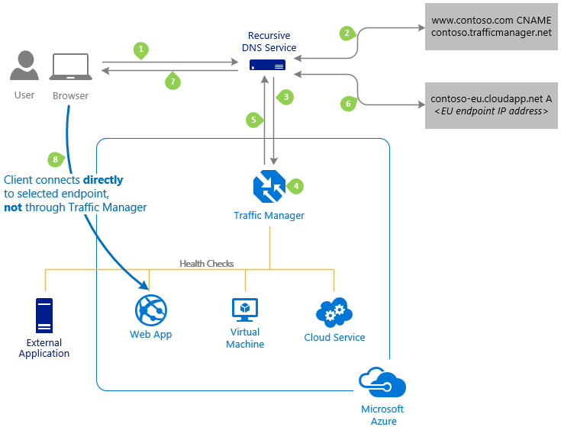
How Traffic Manager Works
Map your domain name contoso.com -> contoso.trafficmanager.net
Map website URLs in one or more regions to your Traffic Manager Profile.
contosoeast.azurewebsites.net
contosowest.azurewebsites.net
Choose the Right Load Balancing Algorithm
Priority, Weighted, Performance, Geographic
www.contoso.com IN CNAME contoso.trafficmanager.net
Select endpoint
contosoeast.azurewebsites.net
contosowest.azurewebsites.net
Notes:
Purpose: explain how Traffic Manager works
Description:
https://docs.microsoft.com/en-us/azure/traffic-manager/traffic-manager-overview#how-traffic-manager-works
The most important point to understand is that Traffic Manager works at the DNS level. Traffic Manager uses DNS to direct clients to specific service endpoints based on the rules of the traffic-routing method. Clients connect to the selected endpoint directly. Traffic Manager is not a proxy or a gateway. Traffic Manager does not see the traffic passing between the client and the service.
The client sends a DNS query to its configured recursive DNS service to resolve the name 'partners.contoso.com'. A recursive DNS service, sometimes called a 'local DNS' service, does not host DNS domains directly. Rather, the client off-loads the work of contacting the various authoritative DNS services across the Internet needed to resolve a DNS name.
To resolve the DNS name, the recursive DNS service finds the name servers for the 'contoso.com' domain. It then contacts those name servers to request the 'partners.contoso.com' DNS record. The contoso.com DNS servers return the CNAME record that points to contoso.trafficmanager.net.
Next, the recursive DNS service finds the name servers for the 'trafficmanager.net' domain, which are provided by the Azure Traffic Manager service. It then sends a request for the 'contoso.trafficmanager.net' DNS record to those DNS servers.
The Traffic Manager name servers receive the request. They choose an endpoint based on:
The configured state of each endpoint (disabled endpoints are not returned)
The current health of each endpoint, as determined by the Traffic Manager health checks. For more information, see Traffic Manager Endpoint Monitoring.
The chosen traffic-routing method. For more information, see Traffic Manager Routing Methods.
The chosen endpoint is returned as another DNS CNAME record. In this case, let us suppose contoso-us.cloudapp.net is returned.
Next, the recursive DNS service finds the name servers for the 'cloudapp.net' domain. It contacts those name servers to request the 'contoso-us.cloudapp.net' DNS record. A DNS 'A' record containing the IP address of the US-based service endpoint is returned.
The recursive DNS service consolidates the results and returns a single DNS response to the client.
The client receives the DNS results and connects to the given IP address. The client connects to the application service endpoint directly, not through Traffic Manager. Since it is an HTTPS endpoint, the client performs the necessary SSL/TLS handshake, and then makes an HTTP GET request for the '/login.aspx' page.

Slide 45
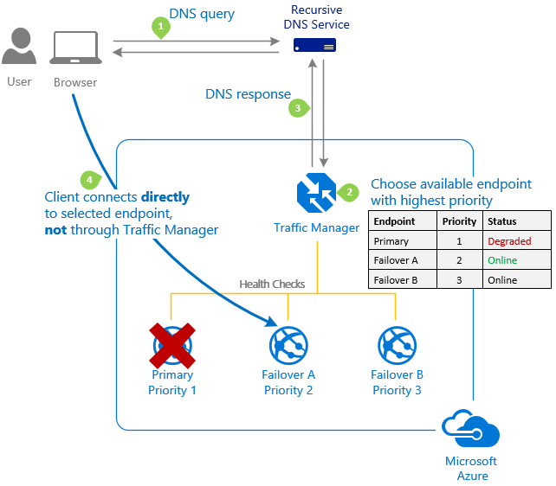
Priority Profile
Select Priority when you want to use a primary service endpoint for all traffic, and provide backups in case the primary or the backup endpoints are unavailable.
Notes:
Purpose: Explain Priority profile of Traffic Manager
Detail:
https://docs.microsoft.com/en-us/azure/traffic-manager/traffic-manager-routing-methods#a-name--priorityapriority-traffic-routing-method
Often an organization wants to provide reliability for its services by deploying one or more backup services in case their primary service goes down. The 'Priority' traffic-routing method allows Azure customers to easily implement this failover pattern.

Slide 46
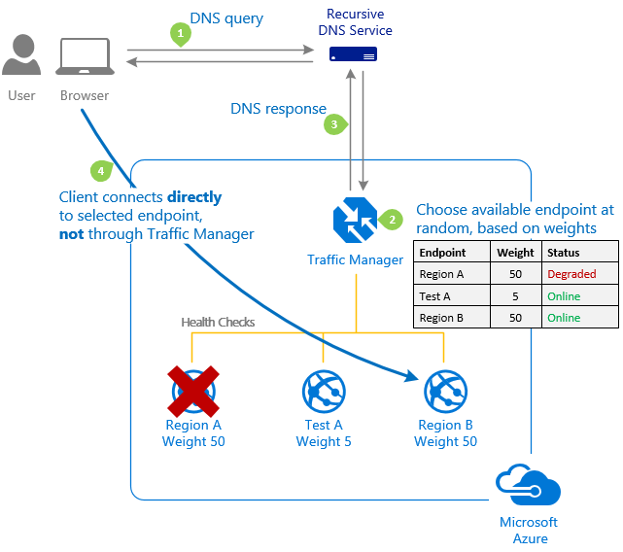
Weighted Profile
The 'Weighted' traffic-routing method allows you to distribute traffic evenly or to use a pre-defined weighting.
Notes:
Purpose: Explain Weighted profile of Traffic Manager
Detail:
https://docs.microsoft.com/en-us/azure/traffic-manager/traffic-manager-routing-methods#a-name--weightedaweighted-traffic-routing-method
In the Weighted traffic-routing method, you assign a weight to each endpoint in the Traffic Manager profile configuration. The weight is an integer from 1 to 1000. This parameter is optional. If omitted, Traffic Managers uses a default weight of '1'.

Slide 47
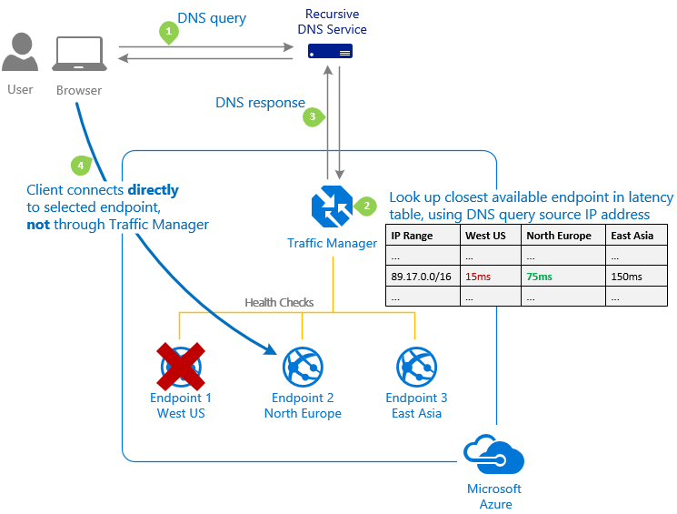
Performance Profile
Deploying endpoints in two or more locations across the globe can improve the responsiveness of many applications by routing traffic to the location that is 'closest' to you. The 'Performance' traffic-routing method provides this capability.
Notes:
Purpose: Explain Performance profile of Traffic Manager
Detail:
https://docs.microsoft.com/en-us/azure/traffic-manager/traffic-manager-routing-methods#a-name--performanceaperformance-traffic-routing-method
The 'closest' endpoint is not necessarily closest as measured by geographic distance. Instead, the 'Performance' traffic-routing method determines the closest endpoint by measuring network latency. Traffic Manager maintains an Internet Latency Table to track the round-trip time between IP address ranges and each Azure datacenter.

Slide 48
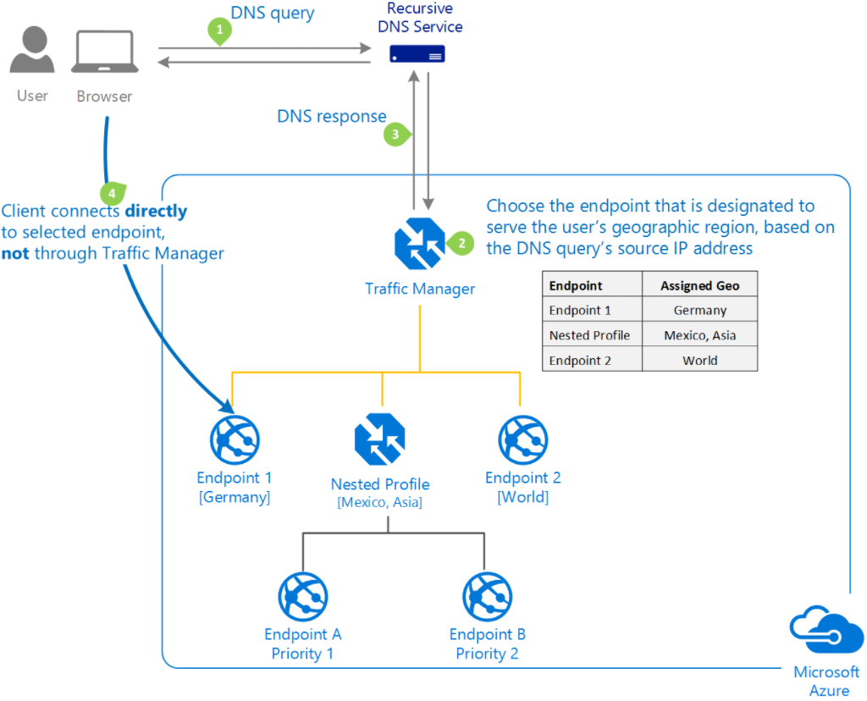
Geographic Profile
Traffic Manager profiles can be configured to use the Geographic routing method so that users are directed to specific endpoints based on which geographic location their DNS query originates from.
Notes:
Purpose: Explain Geographic profile of Traffic Manager
Detail:
https://docs.microsoft.com/en-us/azure/traffic-manager/traffic-manager-routing-methods#a-name--geographicageographic-traffic-routing-method
Traffic Manager reads the source IP address of the DNS query and decides which geographic region it is originating from. It then looks to see if there is an endpoint that has this geographic region mapped to it. This lookup starts at the lowest granularity level (State/Province where it is supported, else at the Country/Region level) and goes all the way up to the highest level, which is World. The first match found using this traversal is designated as the endpoint to return in the query response. When matching with a Nested type endpoint, an endpoint within that child profile is returned, based on its routing method.

Slide 49
Azure Content Delivery Network (CDN)
Notes:
Speed matters. Ensuring a consistent user experience is important. If your websites or mobile apps involve streaming media, gaming software, firmware updates (Smart TVs, consumer electronic appliances) or IoT endpoints (cars, sensors), then Azure Content Delivery Network helps you reduce load times, save bandwidth and increase responsiveness.

Slide 50
How CDN Works?
content from “origin” delivered via edge (POP) servers
static content / dynamic content
Webhost (origin)
Visitor
Visitors
Edge locations/POPs
Visitors
Notes:
In a CDN, content exists in multiple copies on strategically dispersed servers (edge servers, POP –point of presence servers).
A large CDN can have thousands of servers, making it possible to provide identical content to many users efficiently and reliably even at times of maximum Internet traffic or during sudden demand spikes. When a specific page, file or digital asset is requested by a user, the server closest to that user (in terms of the minimum number of nodes between the server and the user) is dynamically determined. This optimizes the speed with which the content is delivered to that user.
A typical website generally contains a mix of static and dynamic content, both of which can affect load times. As you know, user tolerance for slow sites, sluggish apps, and choppy streaming is fading fast. If your site doesn’t load in the first second or two, users will go elsewhere. Search engines use speed as a ranking factor, too – so it has a more direct impact on loyalty and revenue than ever before.
Static content includes fixed object that aren’t capable of action or change, such as code, images, downloads and some media; while
dynamic content (also known as application generated content) consist of actions that take place in real time, and include elements of your site that are personalized to each viewer, such as web applications, SaaS and some media.
All of this effects the performance, availability and reliability of your site, which are key factors in building a successful CDN.

Slide 51
Azure CDN POP Locations
Azure CDN peers with 2,000+ Internet Service Providers (ISPs) to deliver rich content globally
42,000+ networks as of 2012
Over 45 points-of-presence (POPS) aka Edge locations
45 massive capacity POPs globally
https://docs.microsoft.com/en-us/azure/cdn/cdn-pop-locations
Notes:
Speaker Notes:
The Internet backbone is the primary system of networks connecting both major network hubs and Internet users to the Internet itself, much like a human backbone, or spine, that carries information to other parts of the body in the most organized and efficient manner.
North America: 12
South America: 6
North and East Europe: 5
West Europe: 4
South Europe: 2
East Asia: 8
South and Central Asia: 4
Middle East/West Asia: 2
Africa:
Australia and New Zealand: 2
Total = 45
We selected these locations for a number of reasons – most significantly, they are key Internet exchange locations – where the majority of Internet traffic is exchanged from carrier network to carrier network. Locating POPs at these strategic locations enables us to tap into the peering opportunities available at these massive exchange points.
Our POPs are also highly secure, built inside robust data centers managed by industry leaders including Equinix.
Azure CDN POPs are numerous enough that we can place content on the edge near end users (especially large concentrations of users) around the world, but not so diverse that we are unable to effectively cache and serve objects for our customers. Thus, our clients get complete global coverage with very high cache ratios, resulting in extremely cost-effective content delivery.

Slide 52
Azure CDN Static content caching on Edge servers
Traverse from London to West US - More Hops
http://mystorage.blob.core.windows.net/imgs/splash.png
Blob Storage
(West US)
Requested File
User (London, UK)
http://az590680.vo.msecnd.net/imgs/splash.png
Resolved to closest edge endpoint (Less Hops)
CDN Endpoint
(London Europe)
Reduced Latency
Notes:
To explain how Azure CDN consider an origin that is azure storage with a public container holding an asset like an image or video.
If user connects directly to download an asset from a remote location he will experience large network latency due to multiple network hops
However is Azure CDN is enabled to the storage account then user can access the asset using an alternative URL. In this case he is connecting
To the POP server closer to his geographic location meaning the asset will be downloaded faster.
Azure CDN is a “pull cache” meaning that if the asset that the user is requesting is not present on the POP server (either because it is being
Requested the first time or because is has expired) the POP server will transparently connect to Azure storage and download the asset from
Azure datacenter to POP server and then serve it to the user. Subsequent requests are satisfied from the POP node.
For illustration we show Azure CDN enabled for storage account. However you can enable Azure CDN for other origins such as web applications hosted in Azure web App service, Azure Cloud web role or virtual machine or even outside of azure, e.g. traditional hosters.
For understanding how Azure CDN works with web applications please review
https://azure.microsoft.com/en-us/documentation/articles/cdn-websites-with-cdn/

Slide 53
Case Study
Notes:
https://customers.microsoft.com/Pages/CustomerStory.aspx?recid=20881

Slide 54


Next Games born in the cloud to kill zombies
Next Games, maker of the popular mobile strategy game The Walking Dead: No Man’s Land, was already a Microsoft Azure customer, and happy with what it was getting from Azure Cloud Services. But the game developer wanted to lower costs, increase its server flexibility, and position the company for future growth. The answer for all three needs turned out to be adding even more Azure services—in this case, Azure Cosmos DB and Azure Service Fabric. As a result, Next Games was able to optimize its storage usage and database solution, and will soon be getting more out of its virtual servers while saving money.
Microsoft Azure
Azure Cosmos DB
Azure Event Hubs
Azure Media Services
See Notes for Full List
80 employees
Retail and Consumer Goods
Finland
Azure platform
Notes:
Product and Services continued:
Azure Notification Hub
Azure Service Fabric
Azure Traffic Manager
Azure Web Apps
https://customers.microsoft.com/en-us/story/next-games
https://aka.ms/hegoxv

Slide 55



Online retailer uses cloud database to deliver world-class shopping experiences
London-based ASOS is an online fashion retailer on a mission to be the world’s number-one fashion destination for twentysomethings. To support its digital offering, ASOS uses Microsoft Azure Cosmos DB, a scalable, managed database that makes possible such innovations as real-time product recommendations and instant order updates for 15.4 million customers.
Microsoft Azure Cosmos DB
Microsoft Azure Data Lake
Microsoft Azure HDInsight
Microsoft Azure SQL Database
3,600 employees
Retail and consumer goods
United Kingdom
Cloud database
Notes:
https://customers.microsoft.com/en-us/story/asos-retail-and-consumer-goods-azure

Slide 56


Connecting with 500 million passionate fans worldwide
With more than 500 million fans worldwide, the Real Madrid Football Club is among the world’s top sports franchises. But with just a small fraction of those fans in Spain, it needed a way to connect with them—wherever they are in the world—and support their club passion. To accomplish that goal, Real Madrid engaged a Microsoft Services team for help in envisioning, developing, and deploying a global digital sports platform that was built using a wide range of Microsoft cloud services. It takes advantage of the global footprint of Microsoft cloud services to consistently deliver the very best fan experience anywhere in the world. Real Madrid can now engage one-on-one with fans, implement targeted promotional campaigns, and use data to track and analyze fan behaviors, among many other capabilities. Today, club officials report a significant digital revenue growth and could not be more positive about the club’s digital future.
Microsoft Azure App Service
Azure Cosmos DB
Azure Media Service
Visual Studio Team Services
Medium (50-999)
Hospitality & Travel
Spain
Digital Transformation
Notes:
Products
Azure Active Directory
Azure App Service
Azure Application Insights
Cloud Services
Azure Cosmos DB
Azure Data Factory
Azure Media Services
Azure Search
Azure Storage
Azure Stream Analytics
Microsoft Dynamics 365 for Customer Service
Microsoft Dynamics 365 for Marketing
Microsoft Services
Microsoft Office 365
Power BI
Visual Studio Application Insights Plug-in
Visual Studio Team Services
https://customers.microsoft.com/doclink/real-madrid
https://aka.ms/Qvy945

Slide 57
Video References
Building Microservices Applications on Azure Service Fabric
Scalability and Deployment
Design for Scalability
Surviving Success: Architecting Web Sites and Services for Rapid Growth
Building Big: Lessons Learned from Azure Customers

Slide 58
Scaling Guidance References
Scalability checklist
Autoscaling guidance
Data partitioning guidance
Caching guidance
Content Delivery Network (CDN) guidance

Slide 59
Contact Us Technical services to help you win more deals, accelerate deployment and increase consumption
Microsoft Azure
http://aka.ms/PartnerTechnicalServicesAzure
Microsoft CRM Online
http://aka.ms/PartnerTechnicalServicesCRMOnline
Microsoft Office 365
http://aka.ms/PartnerTechnicalServicesO365
Microsoft Windows 10 and Enterprise Mobility Suite
http://aka.ms/PartnerTechnicalServicesWin10EMS
Learn more about your technical support benefits
http://aka.ms/MySupport

